Slide 1

Network Hardware

Slide 2


Objectives
At the end of the session students should be able to
Define the term network hardware
Identify different network hardware
Describe types of network hardware

Slide 3
Network Equipment
In order for a computer to operate on a network, there are ranges of different hardware components that are required.
There are different kinds of Network Equipment
Switches
Router
NIC (Network Interface Card)
Repeaters
Bridges

Slide 4
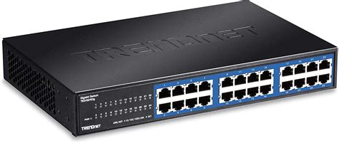
Switches
A switch is a device that connects a number of computers together to make a LAN.
It has different port in which a cable from a computer is inserted into it.
This allows the computer to communicate with the switch and intern communicate with the other devices on the next work

Slide 5
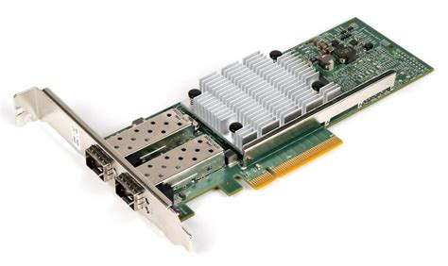
NIC- Network Interface Card
NIC is short for network interface card.
The NIC provides the hardware connection between a computer and a switch.
A NIC can either be wireless or wired
Games consoles contain a NIC card so users can access the internet, download games and play online.

Slide 6
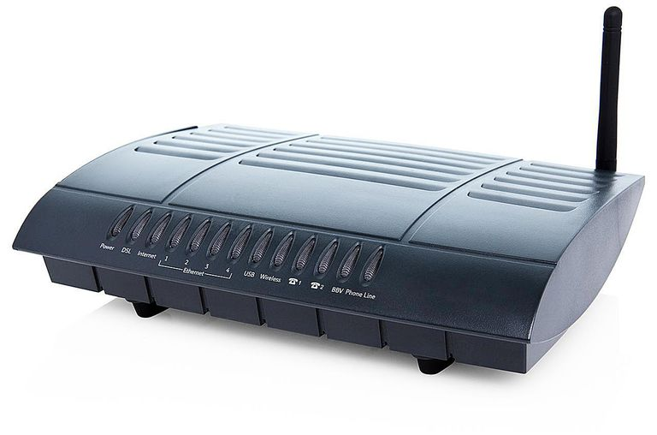
ROUTER
A Router is a device that transfers data from one network to another in an intelligent way, It can be wireless or cabled.
Routers send data to a specific location based on an address for the network other network.

Slide 7
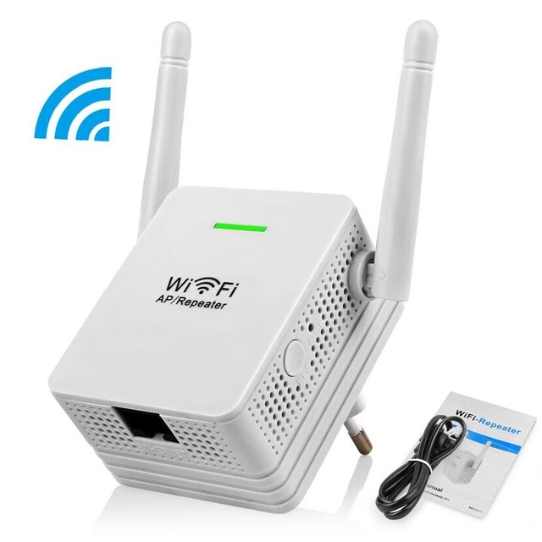
Repeater
Network repeaters are small devices that receive incoming signals and retransmit them to other parts of the network that the regular Wi-Fi signal can't reach.

Slide 8
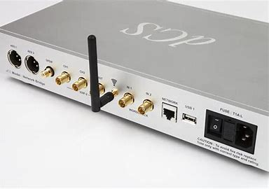
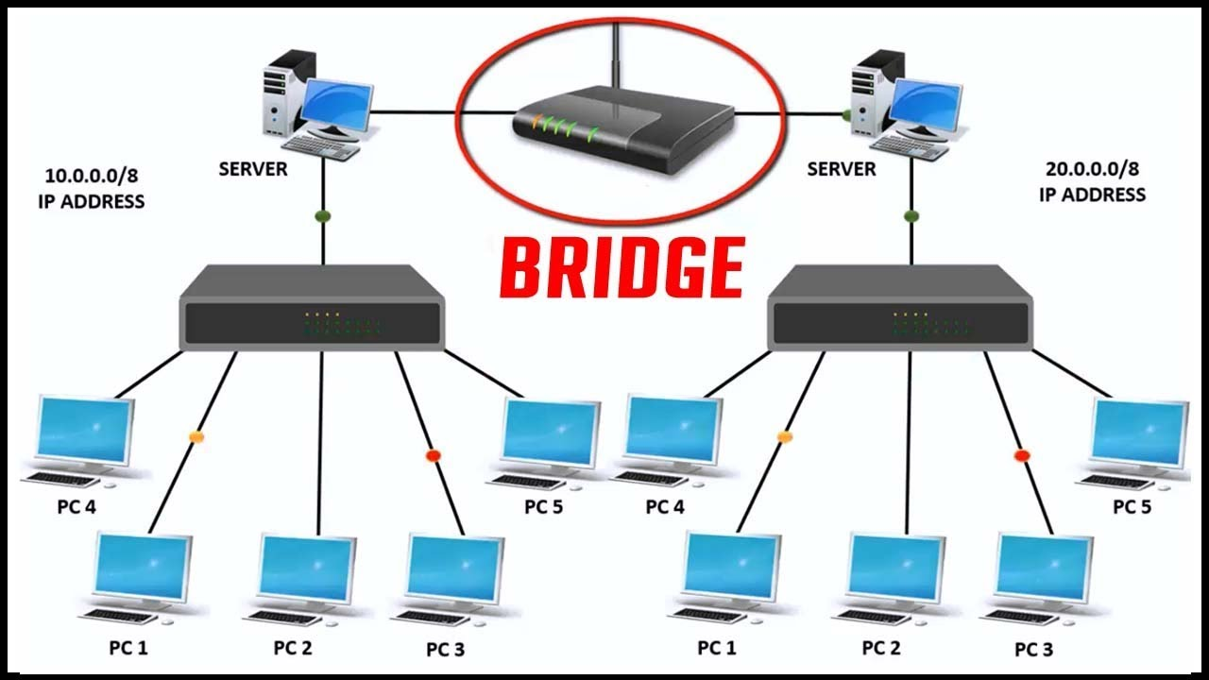
Bridge
A network bridge, also known as a layer 2 switch, is a hardware device used to create a connection between two separate computer networks or to divide one network into two using the same protocol(connection rules)

